Slide 1

INSURANCE POLICY MANAGEMENT
TEAM MEMBERS
Employee ID | Name
2604476 | Sreekanth Reddy
2604004 | Pavan Kalyan
2603944 | Pavan Kumar
2603416 | Sahana
2604636 | Sudha
2603937 | Reegan

Slide 2
INTRODUCTION
The Insurance Management System is a comprehensive web application developed to streamline and digitize the management of insurance policies, catering to both insurance administrators and customers. The goal of this project is to create a robust, dynamic, and secure system where the admin can efficiently manage policies and categories, while customers can easily browse, apply for, and track their insurance policies. Built using Angular for the front-end, Spring Boot for the server-side logic, and MySQL for data storage, the system ensures smooth and intuitive management of insurance services. This project aims to improve the operational efficiency of insurance companies and provide a seamless user experience to customers, ensuring a transparent, accessible, and reliable insurance management platform.

Slide 3
OBJECTIVES
To provide a bug-free application to the policymaker(admin) as well as the customer.
The main objective is to build a secured, robust Insurance Management system where the policies are managed properly.
It maintains the record of customers, policies, buyers’ policies efficiently so that it would be easy to access at any time 24*7.

Slide 4
TOOLS AND TECHNOLOGIES
FRONT-END | BACK-END
Angular | Spring Boot
Nodejs | MYSQL, Hibernate, jpa Server -Tomcat

Slide 5
LIST OF MODULES
ADMIN MODULES | USER MODULES
Login to the portal | Create account (no approval required by admin)
Create Admin Account | Change the password.
View/Update/Delete customer. | Change address, email, mobile.
View/Add/Update/Delete policy category like Life, Health, Motor, Travel | View all policy that are added by admin
View/Add/Update/Delete /Approve policy. | If customer likes any policy, then they can apply for it.
View total policy holder, approved policy holder, disapproved policy holder. | When customer applies for any policy, it will go into pending status, admin can approve it.
Approve policy, applied by customer. | Customer can check status of his policy under history section.
Answer customer question | Customer can ask question from admin.

Slide 6
PORTAL
ADMIN
USER

Slide 7
MODULE DESCRIPTION
ADMIN MODULES:
1. Login to the portal
The admin must authenticate by providing a valid username and password to access the admin panel.
Ensures that only authorized admins can access sensitive policy and customer information.
A login form using Angular with Spring Security or JWT authentication.

Slide 8
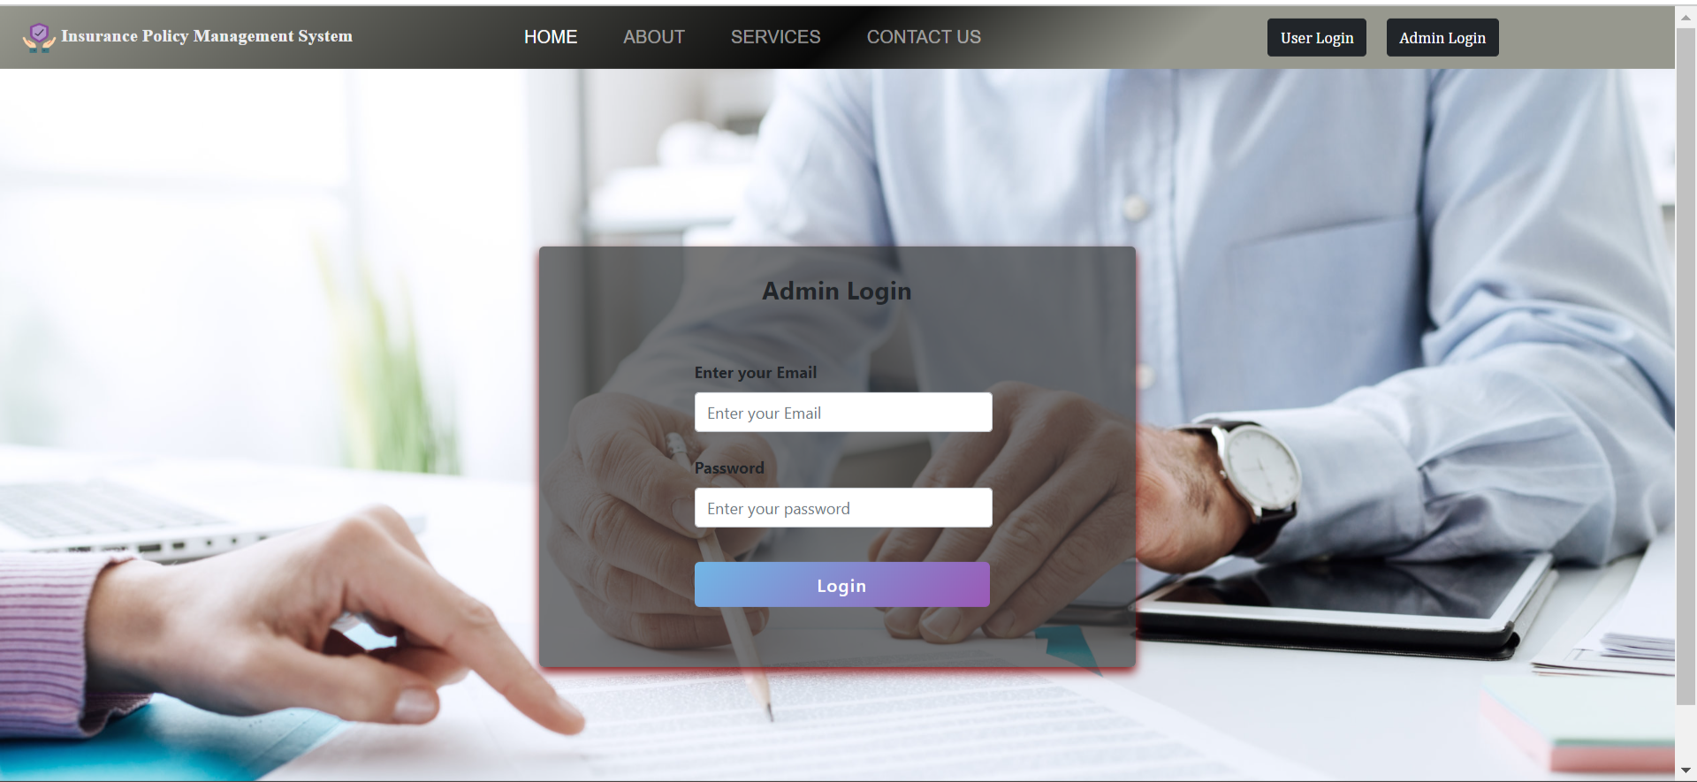
ADMIN LOGIN PAGE

Slide 9
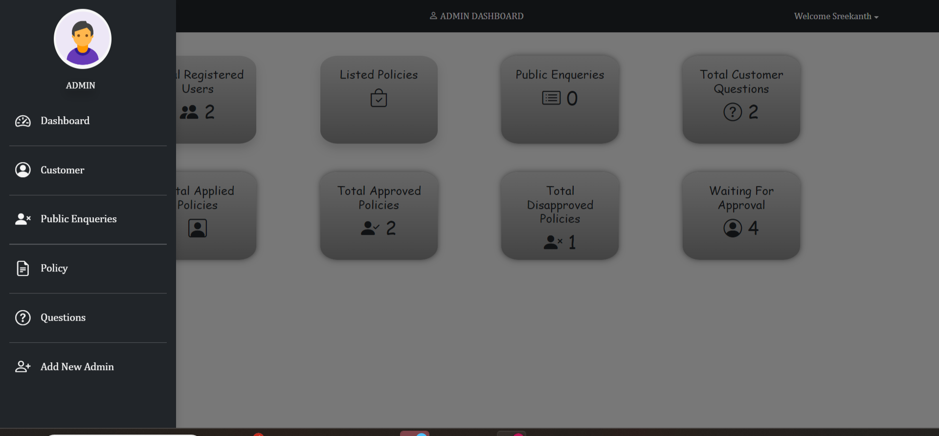
ADMIN DASHBOARD PAGE

Slide 10
MODULE DESCRIPTION
Create Admin Account
Admins have the ability to create new admin accounts, ensuring that multiple administrators can manage the platform.
Admins need to fill in the required details (username, email, password) to create another admin.
Admin account creation can be restricted based on predefined roles and privileges.

Slide 11
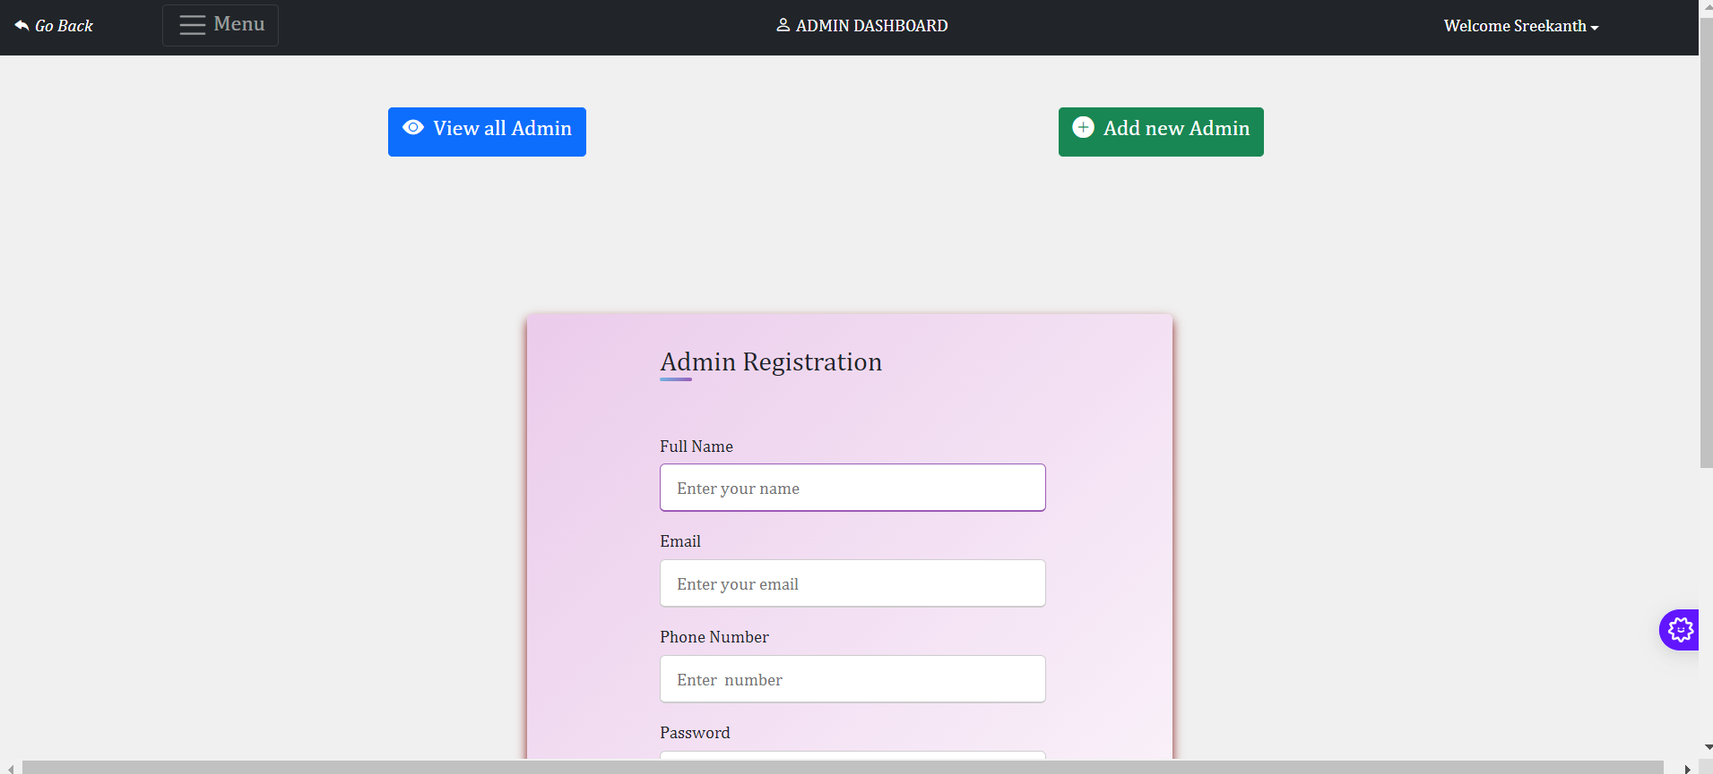
ADMIN REGISTRATION PAGE

Slide 12
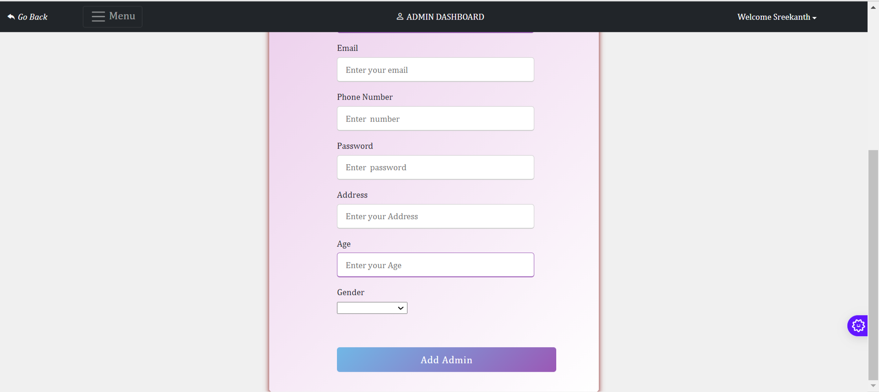
ADMIN REGISTRATION PAGE

Slide 13
MODULE DESCRIPTION
3. View/Update/Delete customer
View: Admins can access a list of all registered customers, including their personal information and associated policies.
Update: Admins can update customer information if needed, such as changing address or contact details.
Delete: Admins can remove customer records from the system.
A customer management dashboard showing customer details with edit and delete functionalities.

Slide 14
MODULE DESCRIPTION
4. View/Add/Update/Delete policy category like Life, Health, Motor, Travel
View: Admins can see all existing policy categories (e.g., Life, Health, Motor, Travel).
Add: Admins can add new categories (e.g., Home, Education) as the insurance offerings expand.
Update/Delete: Existing categories can be updated or deleted as required.
A category management page where admins can manage categories and subcategories.

Slide 15
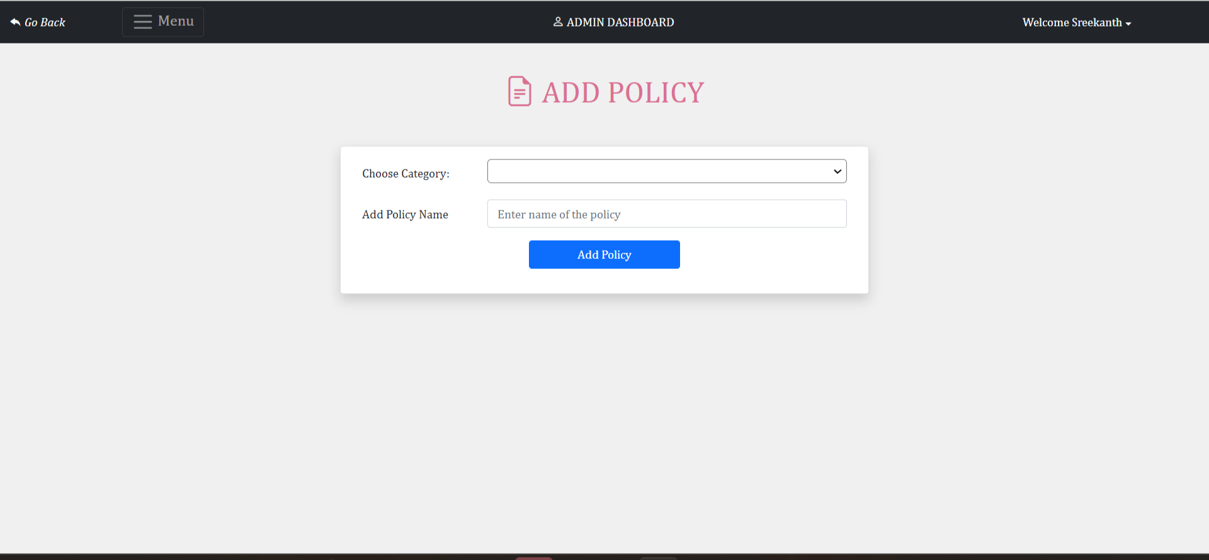
ADD POLICY PAGE

Slide 16
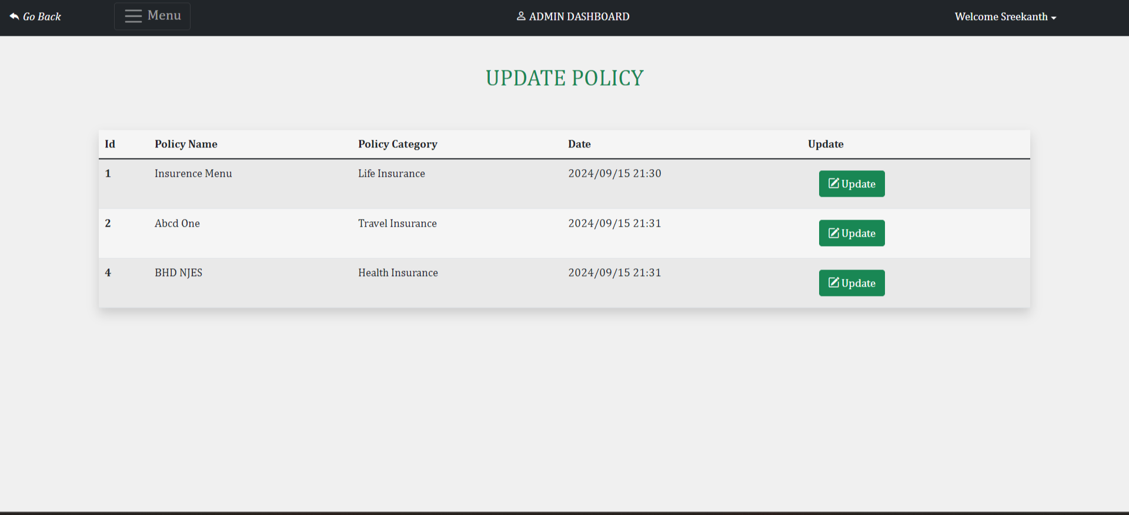
UPDATE POLICY PAGE

Slide 17
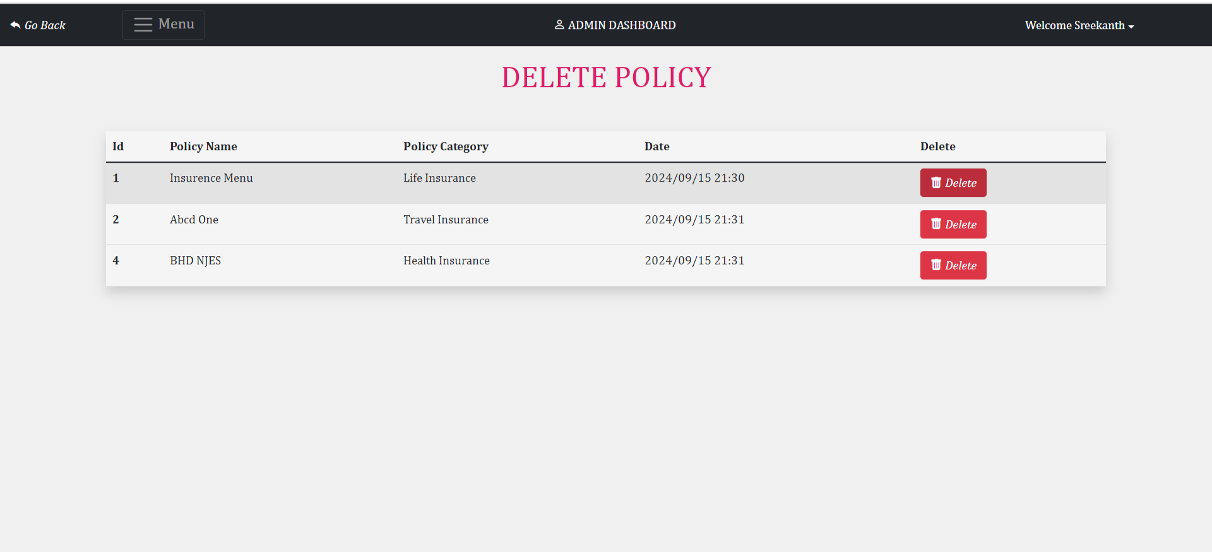
DELETE POLICY PAGE

Slide 18
MODULE DESCRIPTION
5. View/Add/Update/Delete /Approve policy
View: Admins can view all the policies associated with different categories.
Add: Admins can add new policies, providing details like policy name, premium, duration, and terms.
Update/Delete: Admins can modify or delete existing policies if there are changes in coverage or if the policy is no longer available.
Approve: Admins can approve or reject policies applied by customers.
Policies are displayed in a list view, with CRUD (Create, Read, Update, Delete) options for each policy and an approval button for pending requests.

Slide 19
MODULE DESCRIPTION
6. View total policy holder, approved policy holder, disapproved policy holder
Admins can view a summary of all policyholders, including:
Total number of policyholders.
Number of policies that have been approved.
Number of policies that have been disapproved.
A dashboard feature that provides a quick overview of this information with detailed reports.

Slide 20
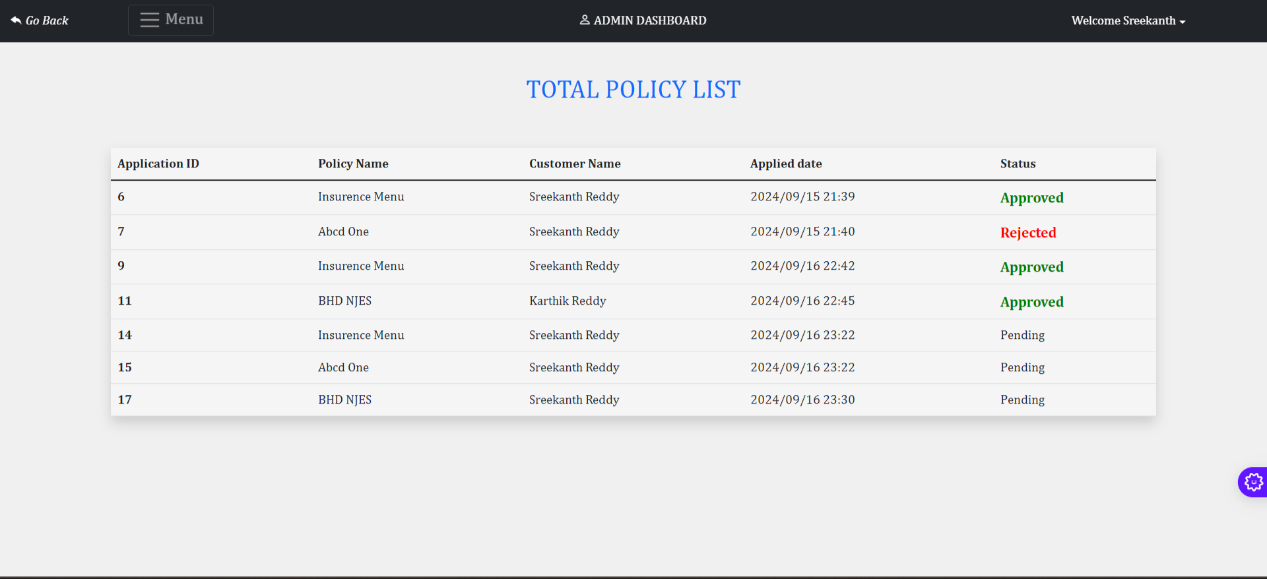
POLICY APPROVE DISAPPROVE PAGE

Slide 21
MODULE DESCRIPTION
7. Approve policy, applied by customer
When a customer applies for a policy, it is placed in Pending status.
Admins can review the application and either approve or disapprove it.
Admins can see a list of pending applications with the option to approve or reject based on business rules.
The system should notify the customer upon approval or rejection.

Slide 22
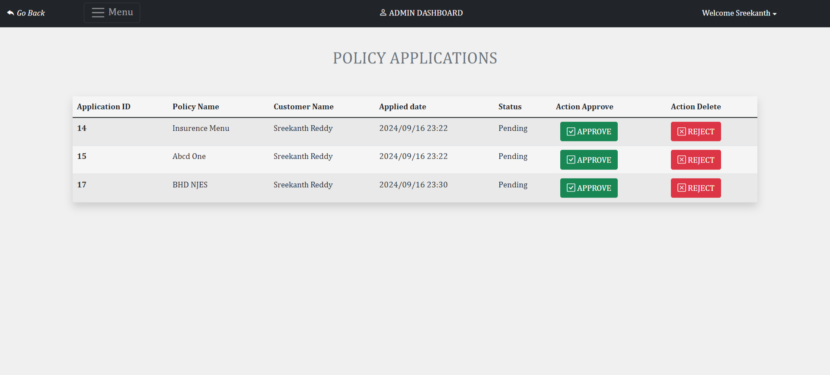
POLICY APPROVAL PAGE

Slide 23
MODULE DESCRIPTION
8. Answer customer question
Customers can submit queries regarding policies or any issues they face.
Admins can view the questions submitted by customers and provide responses.
A Q&A section where questions are listed for the admin to respond, and notifications are sent to customers once the admin replies.

Slide 24
MODULE DESCRIPTION
End User (Customer) Modules
1. Create Account (No Approval Required by Admin)
Customers can sign up on the platform by providing basic details like name, email, and contact information.
No admin approval is required, and the user can immediately access the platform after account creation.
A simple registration form, and once submitted, a new user profile is created in the database.

Slide 25
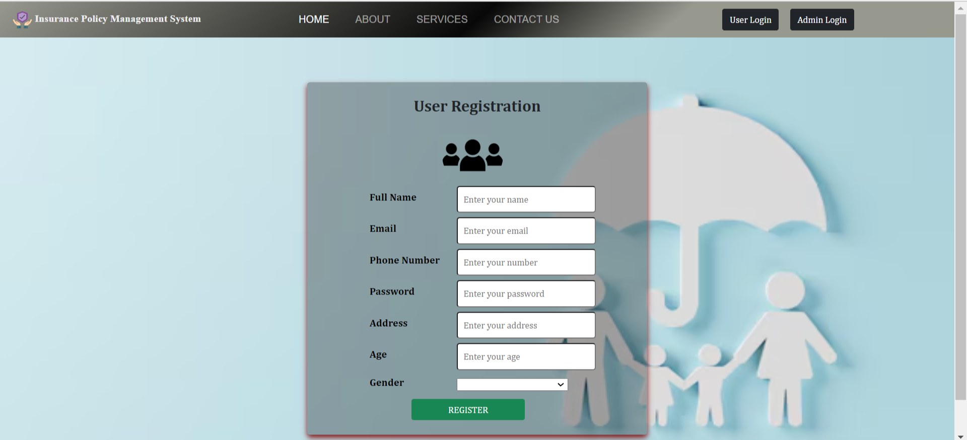
USER REGISTRATION PAGE

Slide 26
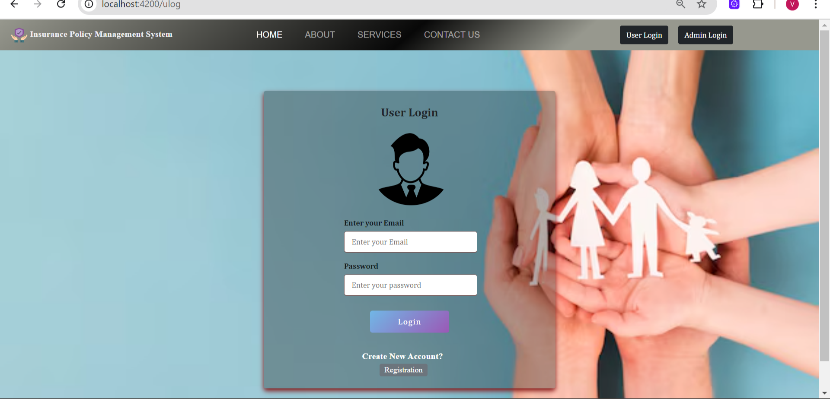
USER LOGIN PAGE

Slide 27
MODULE DESCRIPTION
2. Change Password
Customers can securely update their passwords when required.
A password change functionality, protected by validation to ensure secure password management (e.g., minimum length, special characters).

Slide 28
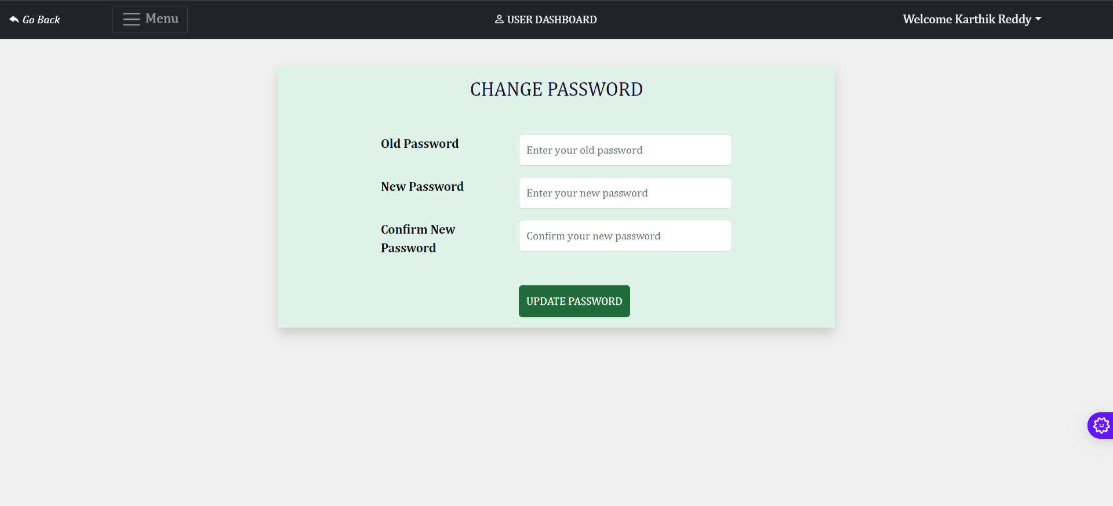
CHANGE PASSWORD PAGE

Slide 29
MODULE DESCRIPTION
3. Change Address, Email, Mobile
Customers can update their personal details, such as address, phone number, and email.
A user profile page where the customer can edit and save their personal details, which updates the corresponding database records.

Slide 30
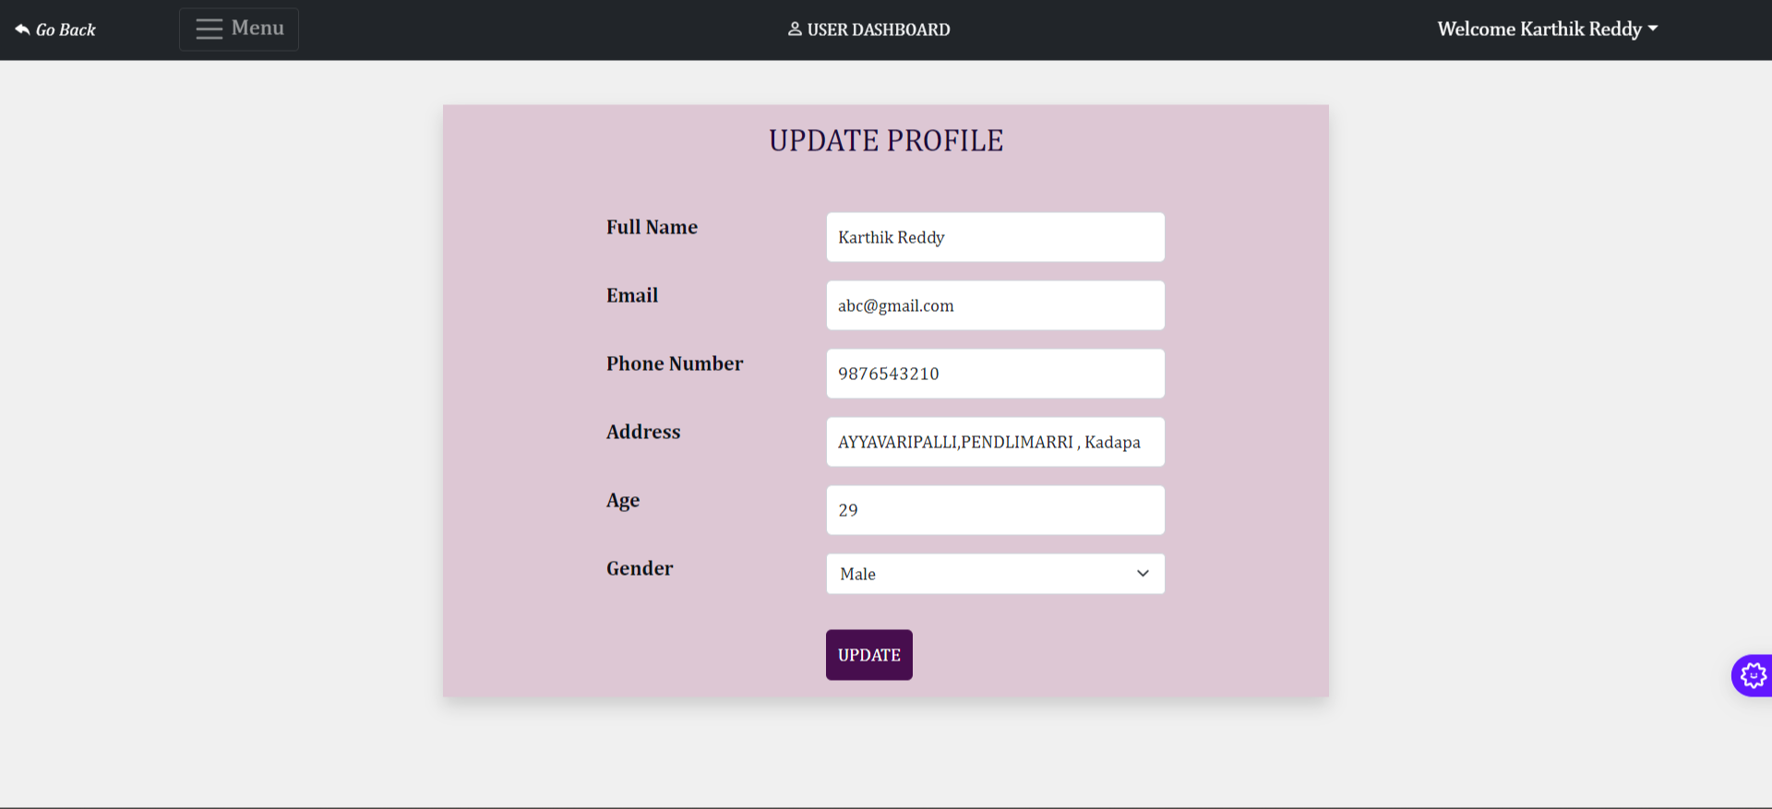
UPDATE PROFILE PAGE

Slide 31
MODULE DESCRIPTION
4. View All Policies that are Added by Admin
Customers can browse through all the policies available on the platform that have been added by the admin.
Policies are categorized (e.g., Life, Health, Motor, Travel) for easy navigation.
A policy listing page where customers can see detailed descriptions, premiums, and terms of each policy.

Slide 32
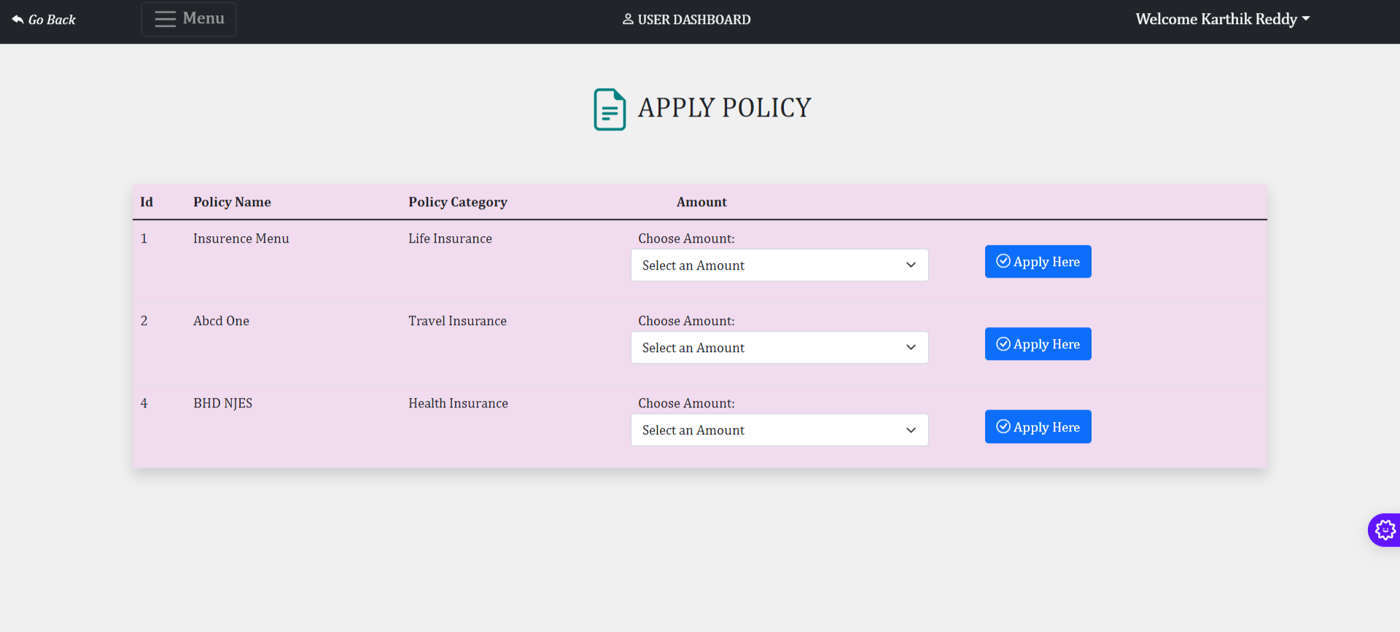
POLICY PAGE

Slide 33
MODULE DESCRIPTION
5. If customer likes any policy, then they can apply for it
Customers can apply for any policy they are interested in. Once applied, the policy will be in Pending status until it is approved by an admin.
When a customer clicks "Apply" for a policy, an application is created in the system, and its status is set to Pending.

Slide 34
MODULE DESCRIPTION
6. When customer applies for any policy, it will go into pending status, admin can approve it
Customers can check the status of the policies they have applied for.
Pending: The application is waiting for admin approval.
Approved/Rejected: The policy status will be updated once reviewed by the admin.
A "Policy History" section where customers can track the status of each policy application.

Slide 35
APPROVAL PAGE

Slide 36
MODULE DESCRIPTION
7. Customer can check status of his policy under history section
Customers can see a history of all the policies they have applied for, including both active and expired policies.
A detailed view of past and present policy applications, including information on start dates, expiry dates, and status updates.

Slide 37
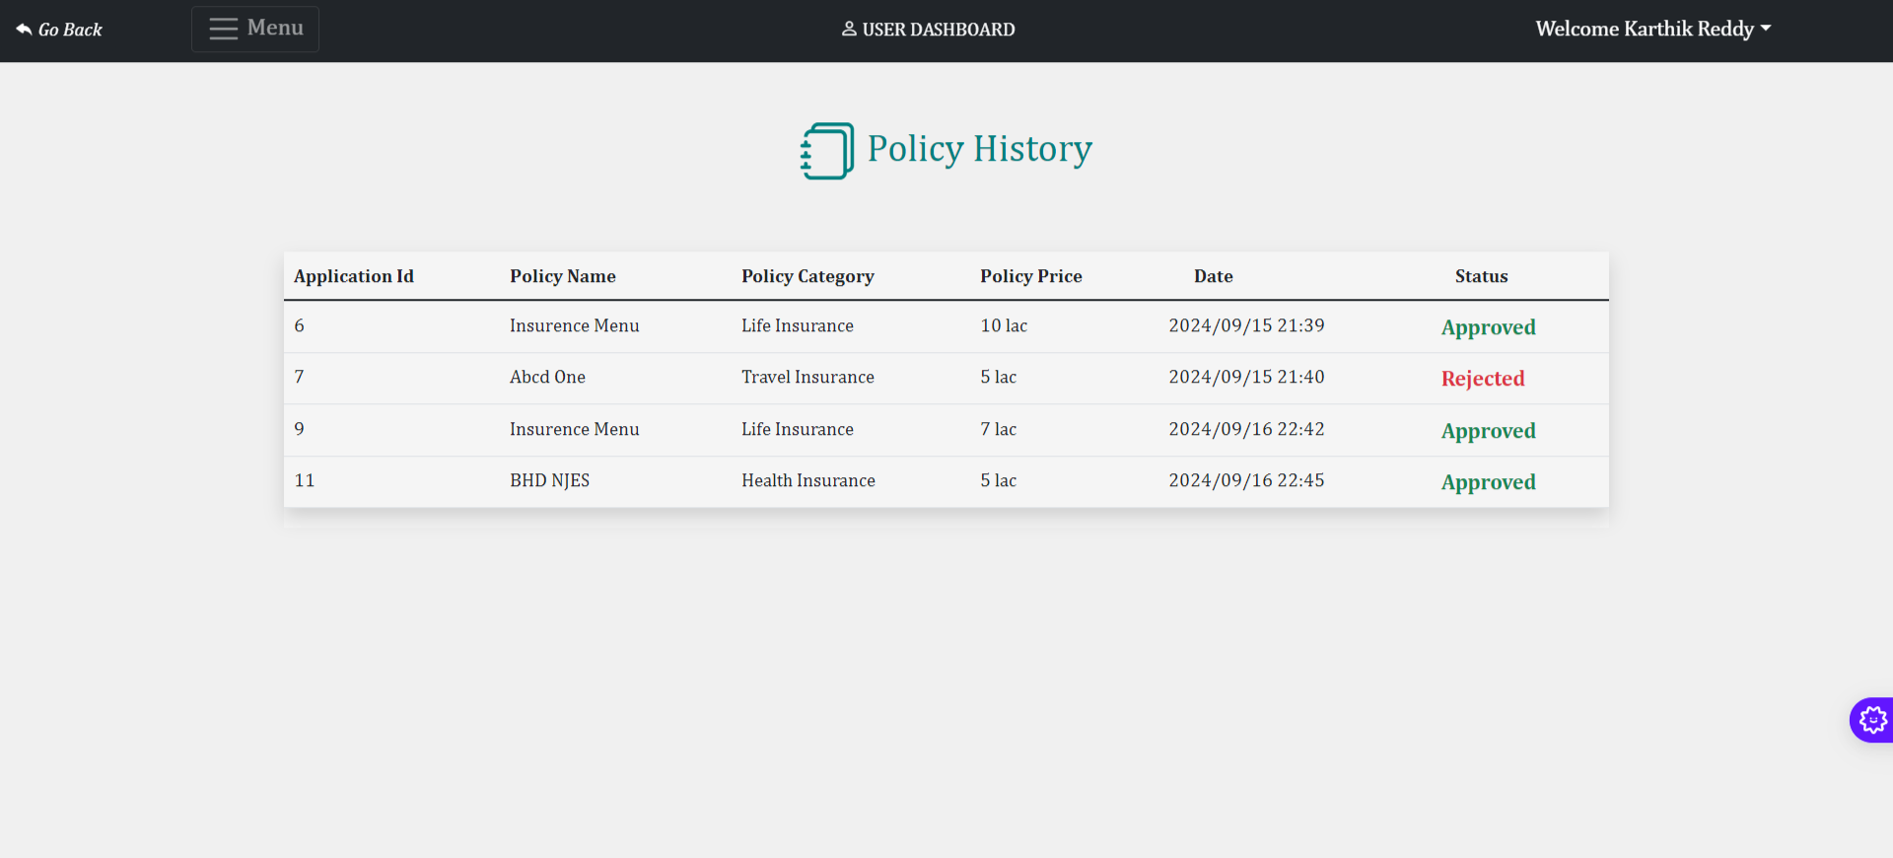
POLICY HISTORY PAGE

Slide 38
MODULE DESCRIPTION
8. Customer can ask question from admin
Customers can raise queries or seek clarification regarding any policy or issue on the platform.
A contact or help section where customers can submit questions. These questions will be forwarded to the admin for response.
These modules are designed to streamline the interaction between the admin and the customer while providing a secure and user-friendly experience for both roles. Each module is crucial for ensuring that the system functions properly, allowing users to manage their policies and admins to oversee platform operations effectively.

Slide 39
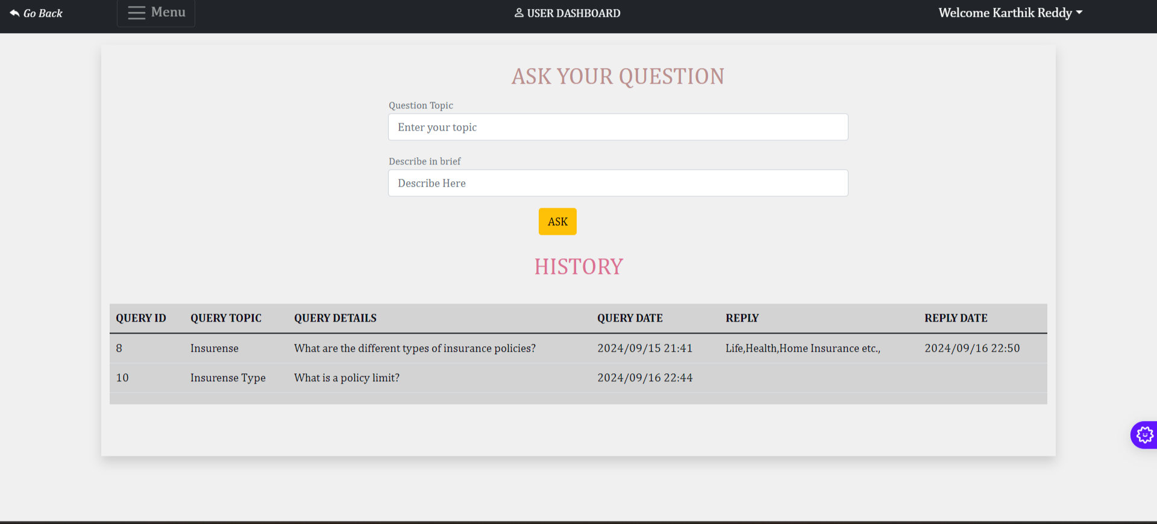
CUSTOMER QUERY PAGE

Slide 40
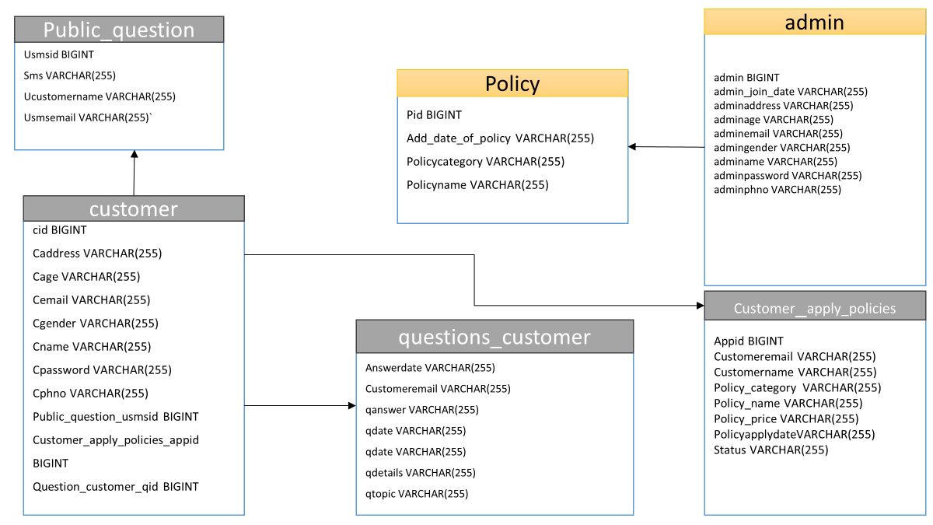
ER DIAGRAM

Slide 41
CONCLUSION
Admins can effectively handle policy creation, updates, customer management, and query resolution, while customers can apply for policies, monitor their applications, and interact with the admin. This project not only enhances operational efficiency but also offers customers a user-friendly interface to manage their insurance needs. The platform is designed with scalability and flexibility in mind, making it adaptable for future expansion as the insurance industry evolves. Ultimately, this project serves as a foundation for a more connected and streamlined insurance service ecosystem.

